Slide 1
Welcome to Year 1
Curriculum Meeting September 2025

Slide 2
The Year 1 Team
Class 4
Teacher: Miss Deeming
Class 5
Teacher: Mrs Wilson
Year Group Leader
Class 6
Teacher: Mr Tonks
Teaching Assistants: Mrs Matthews, Miss Porter & Mrs Kasujee
Additional support staff:
Mrs Hibbard, Mrs Wootton, Mrs Matharu, Mrs Aujla, Mrs Paul

Slide 3
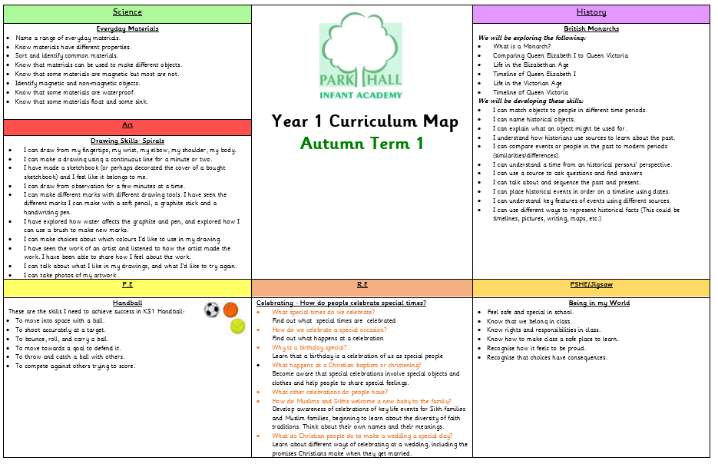
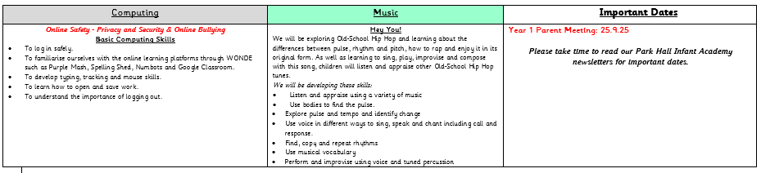

Slide 4
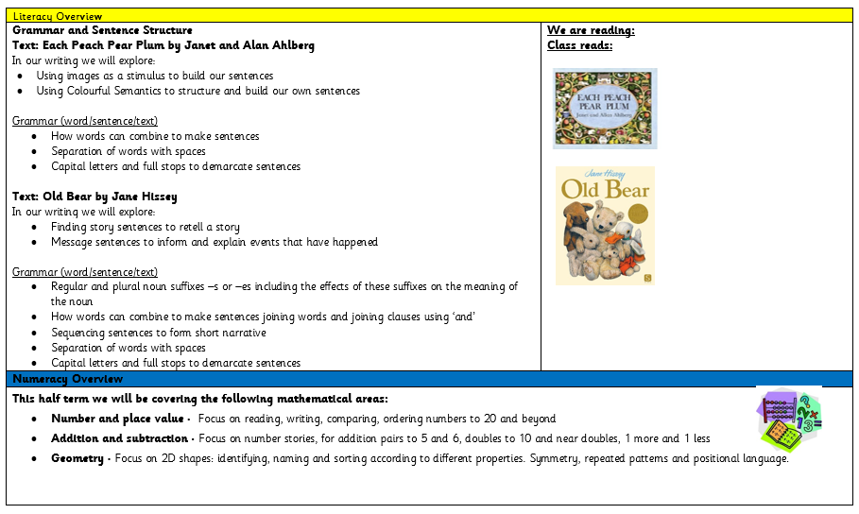

Slide 5
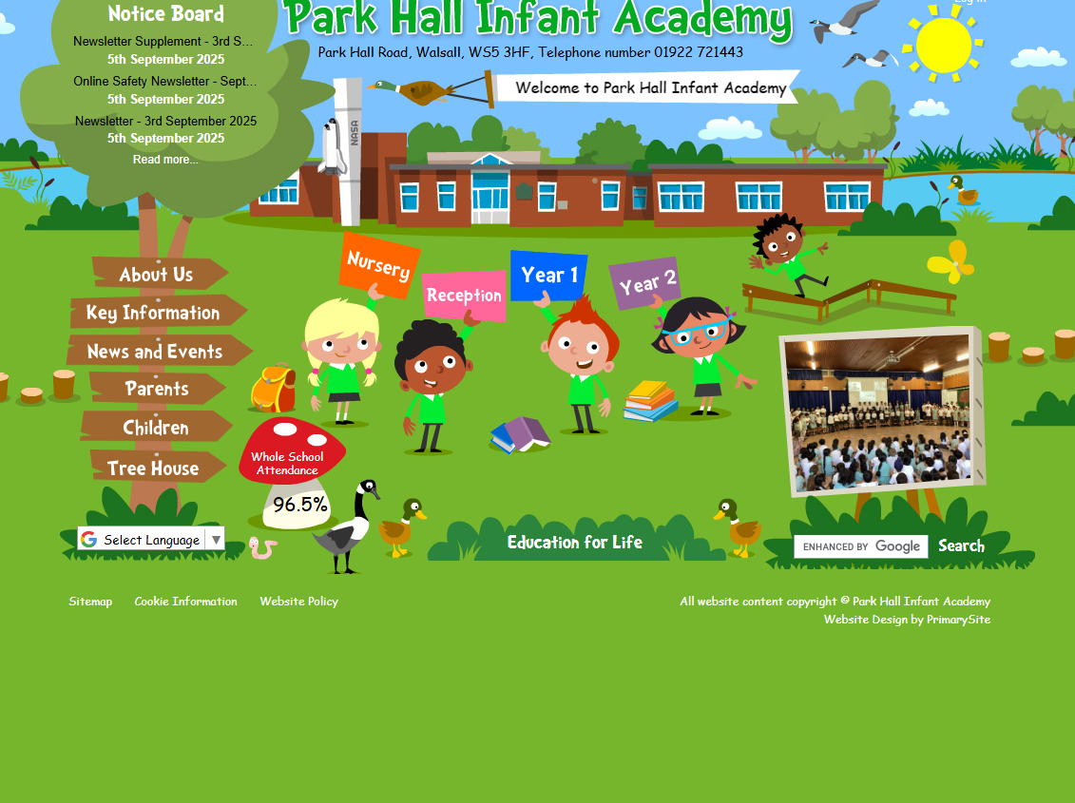
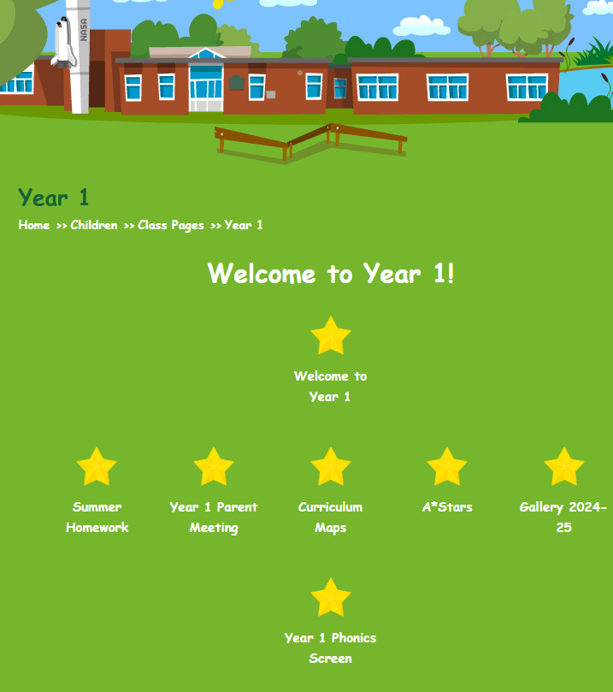
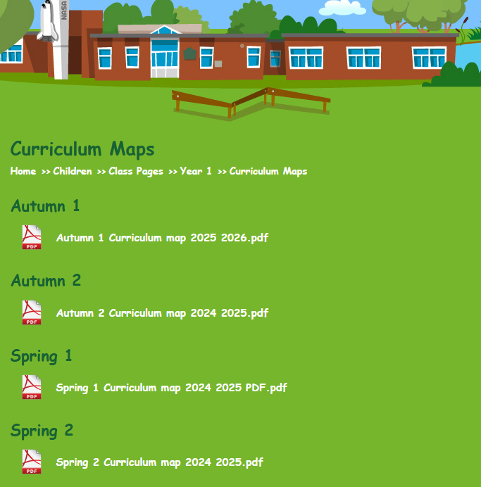
Curriculum Maps
Half termly curriculum maps can be found on the school website

Slide 6


Phonics Books
  They will bring home their RWI ‘Book Bag Book’ on Monday to share at home. This book will have been shared with an adult during a guided group session during the week. They will read their book EVERY DAY independently. Please keep book in their school bag every day.
  Children are assessed every 6 weeks and grouped accordingly
  They will bring home their RWI phonic book on Friday to share at home over the weekend.

Slide 7
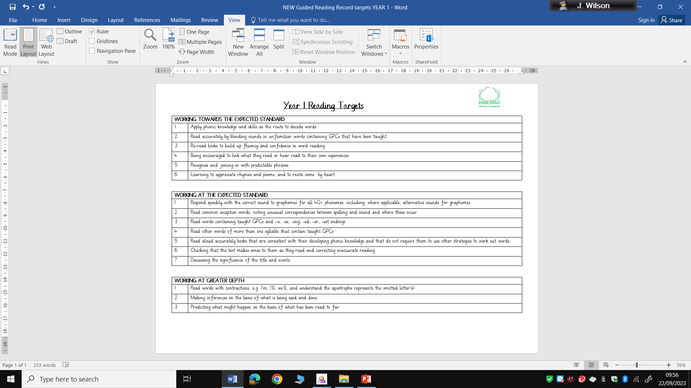
Reading Expectations
Guided Reading
1 Developing
2 Approaching
3 Proficient
4 Excelling
Reading scale: | Comprehension:
Phonetic reading 1: errors with some sounds. 2: sounding out phonemes correctly, blending with support. 3: blending confidently, occasional errors. 4: sight reading many words, some words blended. Red Words 1: help and prompting needed 2: help and prompting needed at first, then recognises when repeated 3: some hesitancy, but generally accurate 4: sight reading red words confidently | a: discuss word meanings (1: didn’t know what it meant; 2: didn’t know but could then apply once told; 3: could explain the word meaning) b: make inferences (1: unable to make a suitable inference; 2:made a suitable inference without explanation; 3: explained a suitable inference) c: make predictions (1: unable to make a suitable prediction; 2: made a suitable prediction without explanation; 3:explained a suitable prediction) d: retrieval (1:cannot find an answer in a text; 2: finds the answer with support; 3: finds the answer independently)

Slide 8

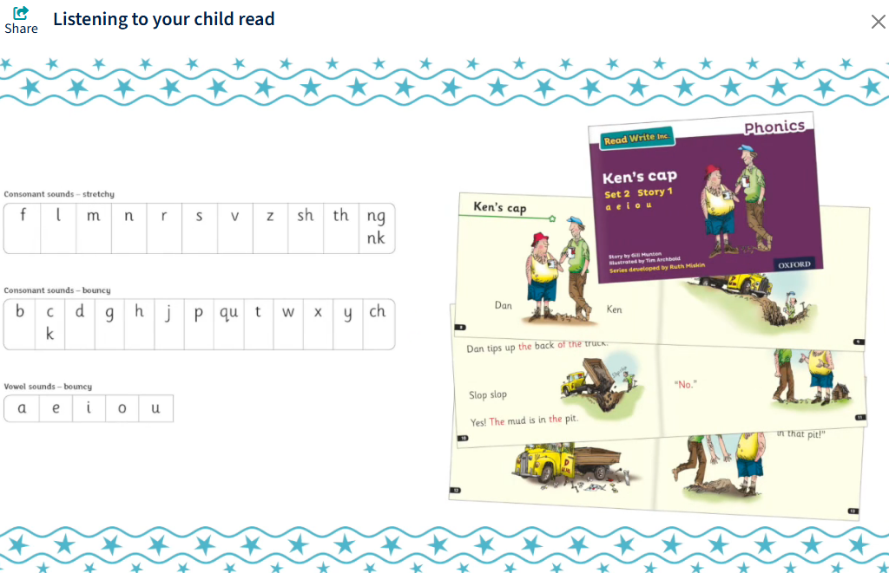
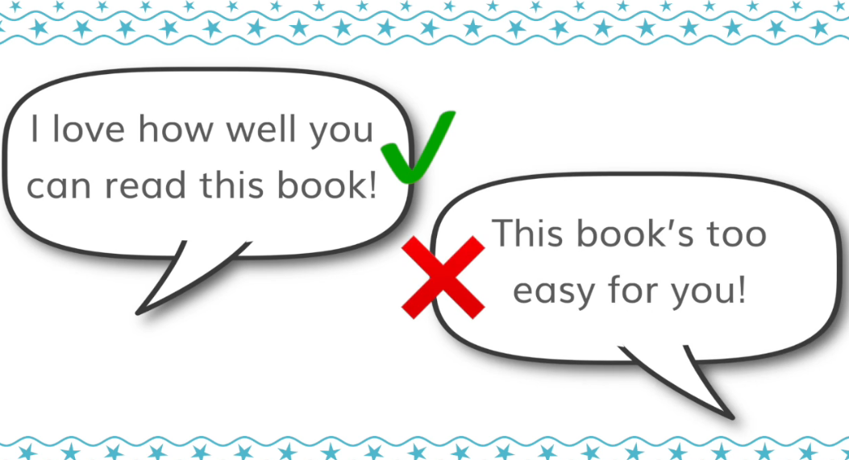
Listening to your child read
Books are matched to the sounds your child can read.
They will have read the book in class and this is an opportunity for them to showcase their skills.

Slide 9
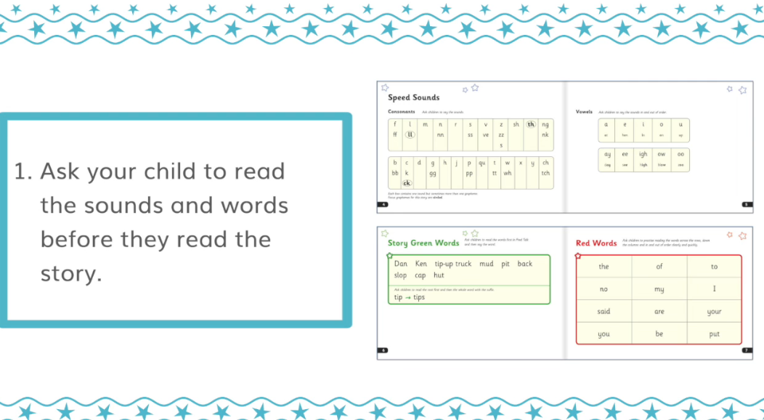
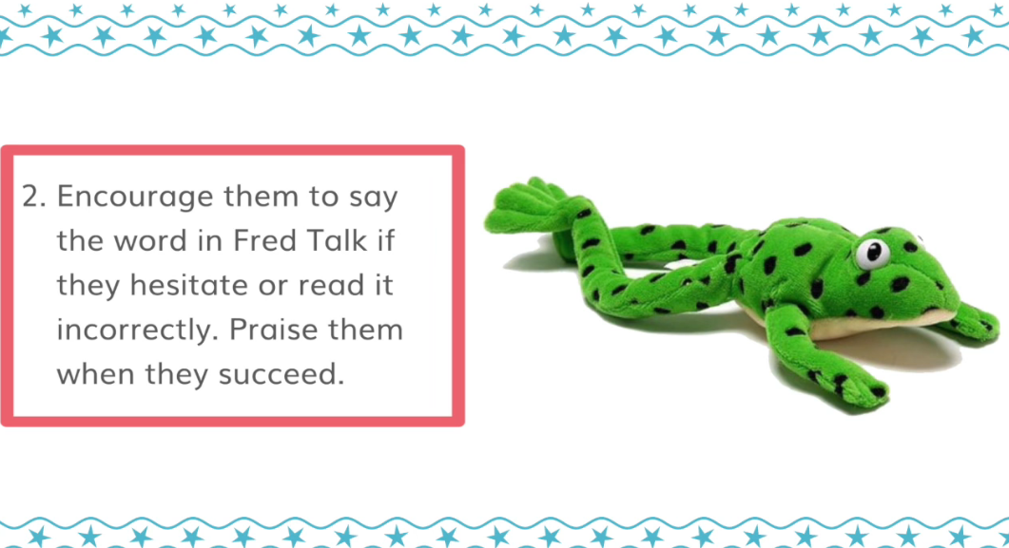
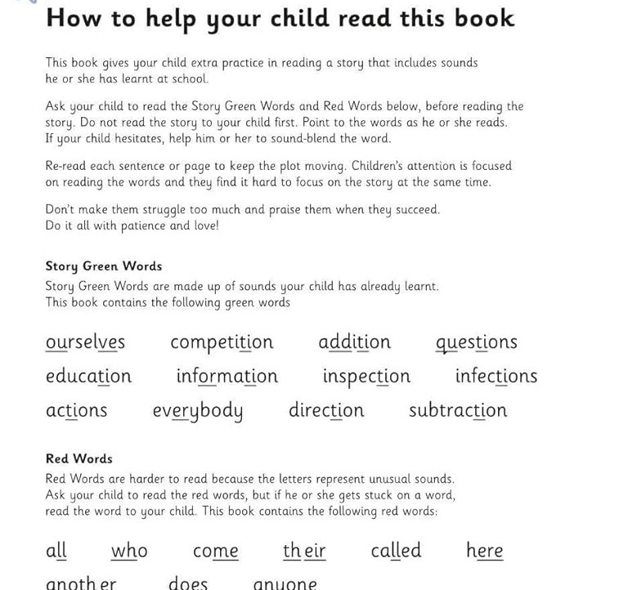
Listening to your child read

Slide 10
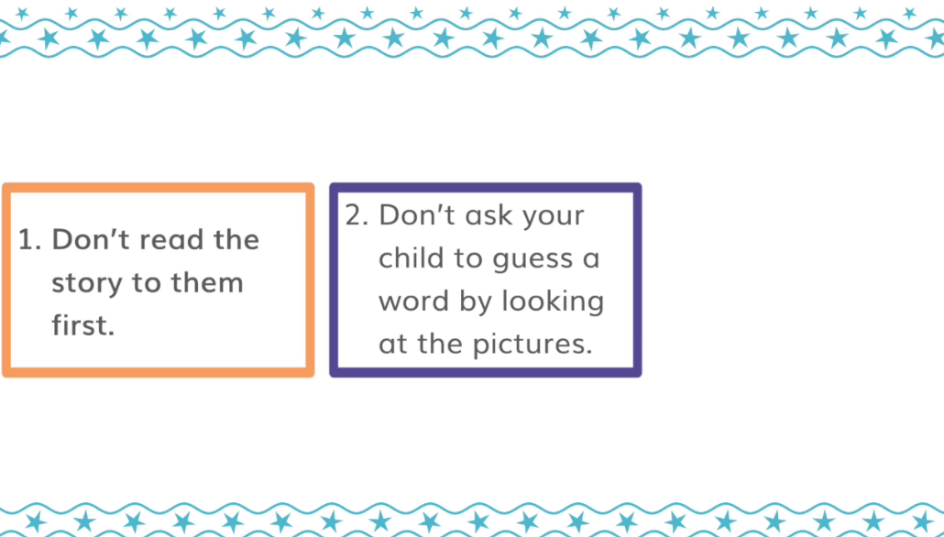

Listening to your child read
3.
Keep smiling and be positive!

Slide 11
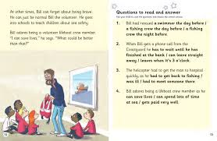


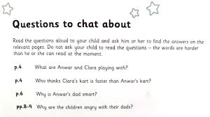
Comprehension
RWI
Fastest finger (FF)
RWI
Have a Think (Hat)

Slide 12
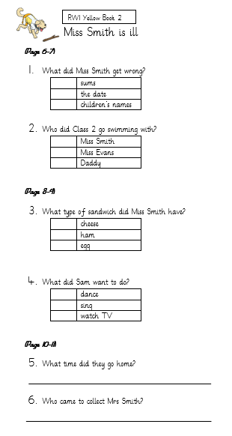
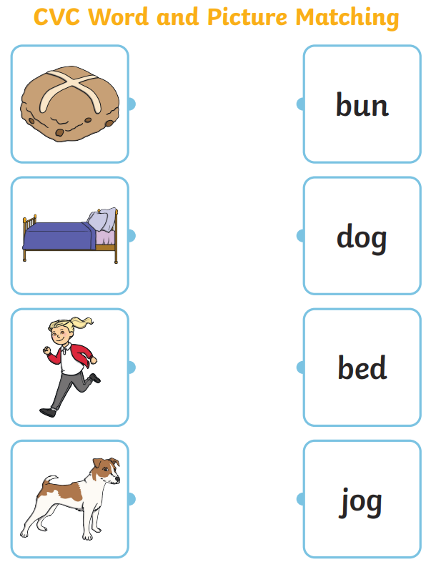
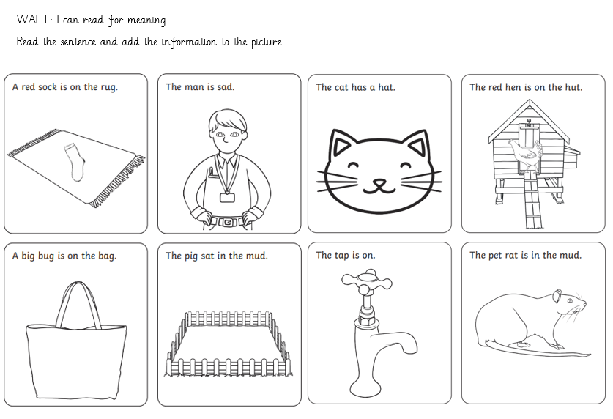
Comprehension
RWI
Fastest finger (FF)
RWI
Have a Think (Hat)

Slide 13
What you can do to help your child with reading
Celebrate reading and sharing their school books - and PLEASE return the books back to school.
Record their home reading in their reading record books.
Share books with your child daily, even if you do not have one from school – reading for pleasure. Bed time!
Talk to your child all the time and ask them questions to support their understanding.

Slide 14
Year 1 Phonic Screen
All children in Year 1 are screened.
Read/decode 40 words-
20 are real words
20 words are nonsense (pseudo) words.
Why are the children being screened?
The phonics check is an assessment of the phonics skills of pupils at the end of Year 1. It assesses their ability to break down and blend words. It is not a reading test, it is a decoding test. It will assess whether children have sufficient decoding and blending skills.

Slide 15
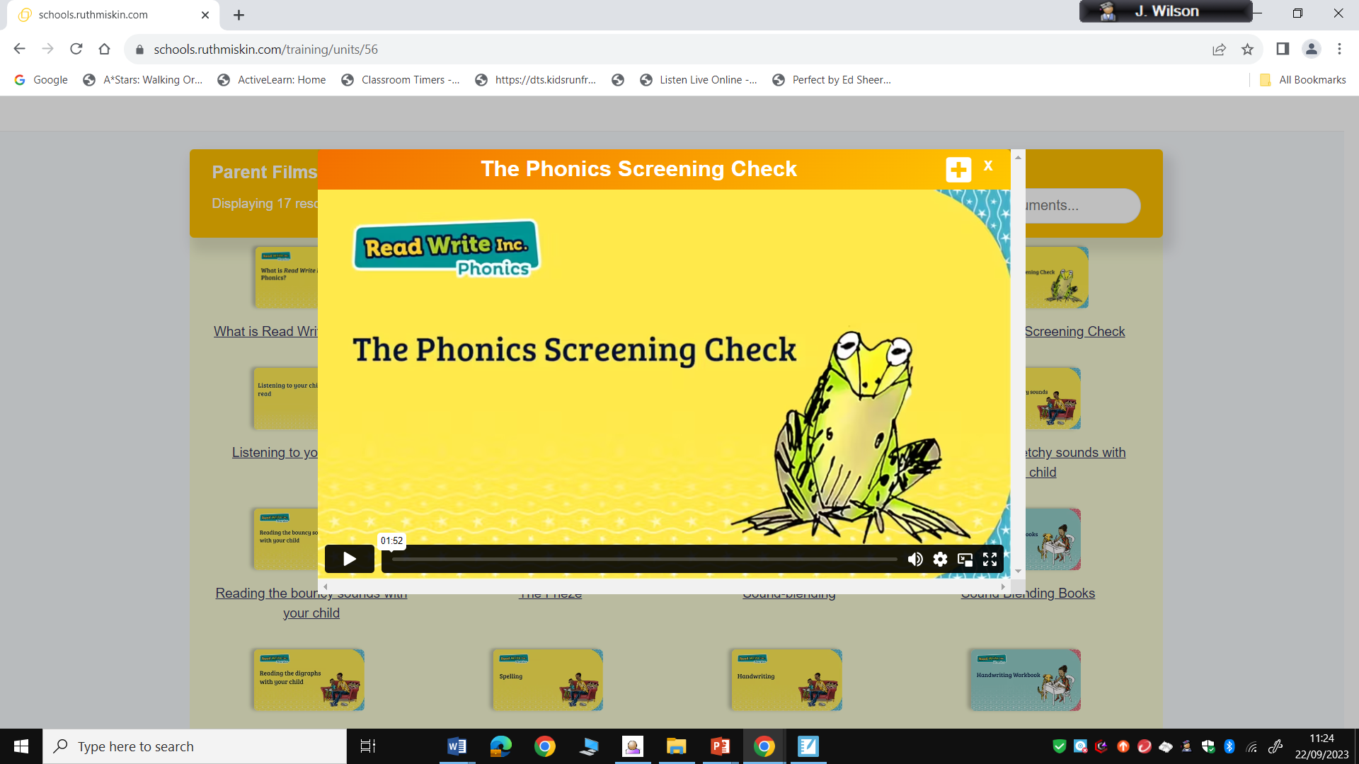
Year 1 Phonic Screen
https://schools.ruthmiskin.com/training/units/56

Slide 16



Year 1 Phonic Screen
20 nonsense words-
alien showed
20 real words

Slide 17
Year 1 Phonic Screen
Screening will take place...
W/C: 9th June 2025
Absent pupils have until Friday 20th June
Class Teacher screens the child.
It will take around 10 minutes although all children are different.
If children do not meet the expected standard in the screening they will be screened again in Year 2.
Children will receive a certificate with their score on in their end of year report.

Slide 18
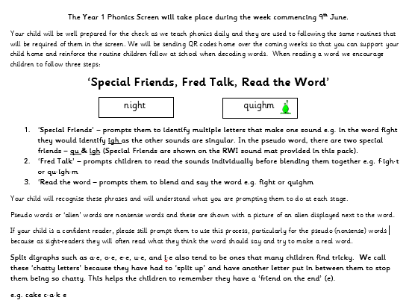
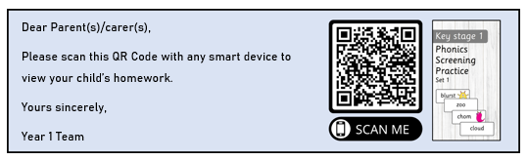
Year 1 Phonic Screen

Slide 19
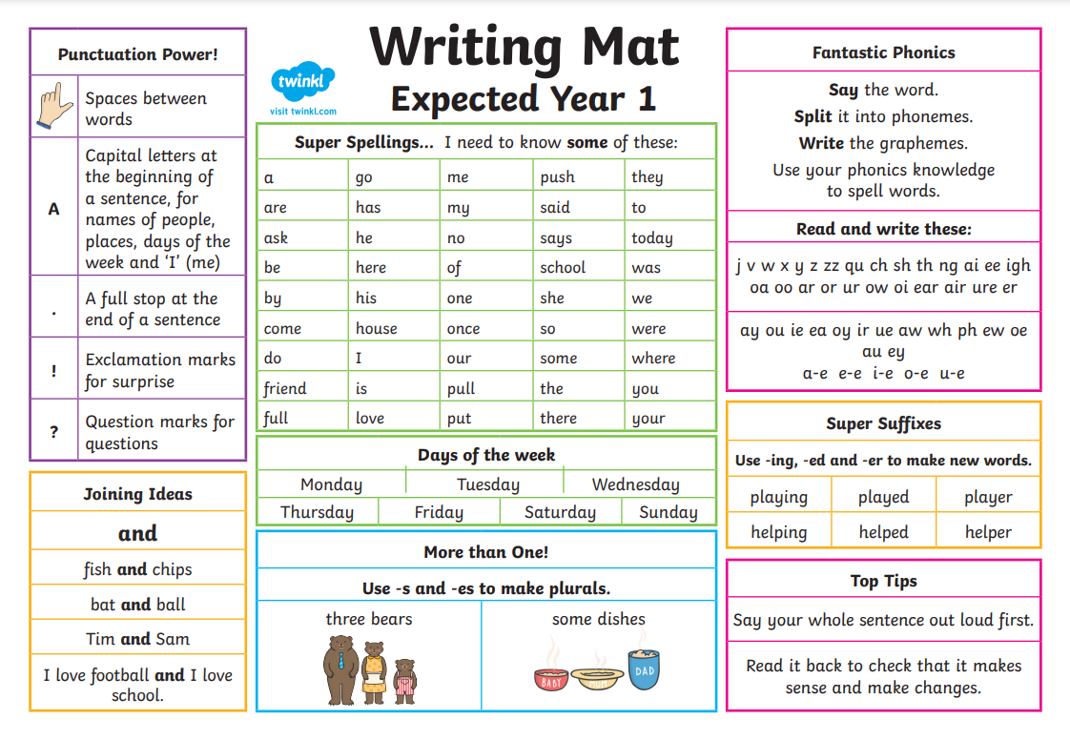
Writing Expectations

Slide 20
Writing Expectations
The pupil can, after discussion with the teacher:
read own writing aloud clearly for others to hear and discuss
orally rehearse sentences and sequence them to form short narratives
join words and clauses with the conjunction ‘and’
use past, present and future accurately in speech and begin to incorporate these in their writing
demarcate many sentences using a capital letter and a full stop, question mark or exclamation mark
spell some Y1 common exception words* and the days of the week
segment spoken words into phonemes and represent these by graphemes, spelling many words in a phonically-plausible way
form many letters and digits correctly, with some difference between upper and lower-case letters
use spaces between words.

Slide 21
Handwriting Expectations
Sit correctly at a table, holding a pencil correctly.
Begin to form lower case letters in the correct direction, starting and finishing in the right place.
Form capital letters.
Form digits 0-9
Correctly position letters on the line.
Form letters of a regular size and shape.

Slide 22
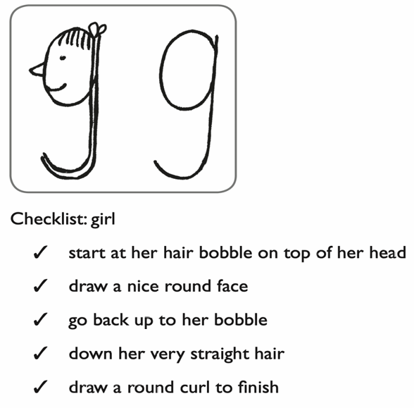

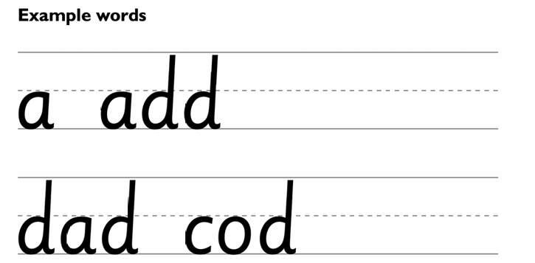
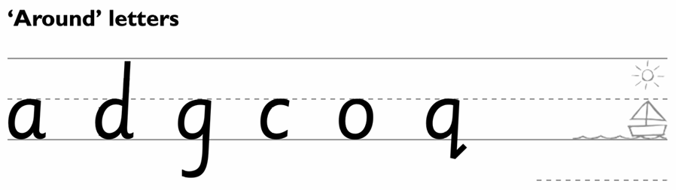
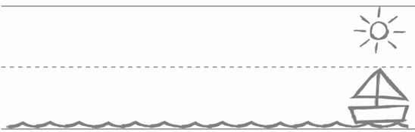
RWI Handwriting
There are regular timetabled slots for handwriting to ensure that children build up their handwriting skills regulalry.
We make the physical process of writing – handwriting – enjoyable from the start, so children see themselves as ‘writers’.
We use mnemonics – memory pictures – to help children visualise the letter before they write it down.
Children practise handwriting under the guidance of an adult so they do not develop habits that will be difficult to undo later.
Please don’t ask children to copy or trace letters or words. We need their attention to be focused on their own formation of the letters.
Each letter has its own checklist to help children visualise and form letters correctly.
Year 1
Stage 1a: Children practise correct letter formation.
Around letters: c a o d g q
Down letters: l d t b k h i j m n r u y
Curly letters: e f s
Zig zag letters: v w z x
Stage 1b: Children learn where to place the letters on the writing line.

Slide 23
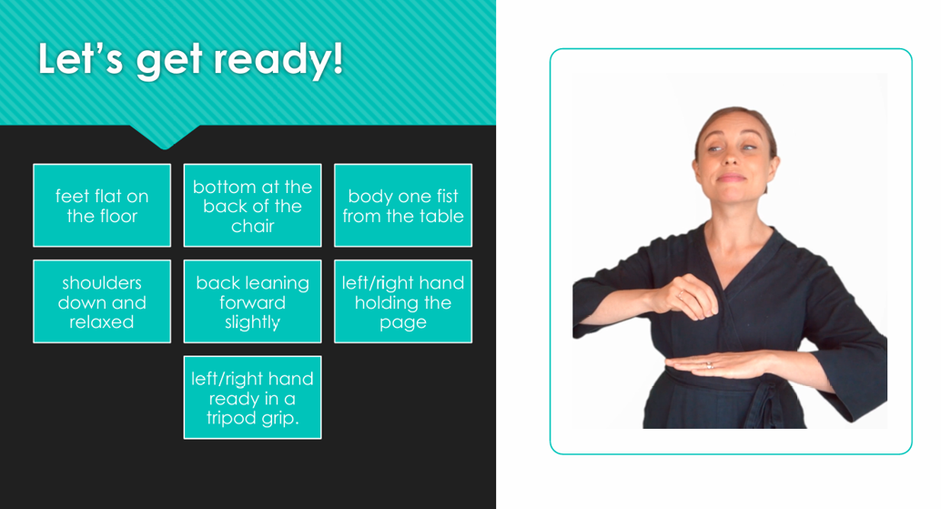

Slide 24

Handwriting Expectations
The cat sat on the mat.

Slide 25
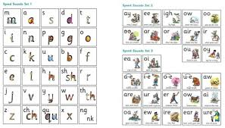

Spellings
Segment spoken words into phonemes and represent these by graphemes, spelling many words in a phonically-plausible way
Spell some Y1 common exception words* and the days of the week

Slide 26
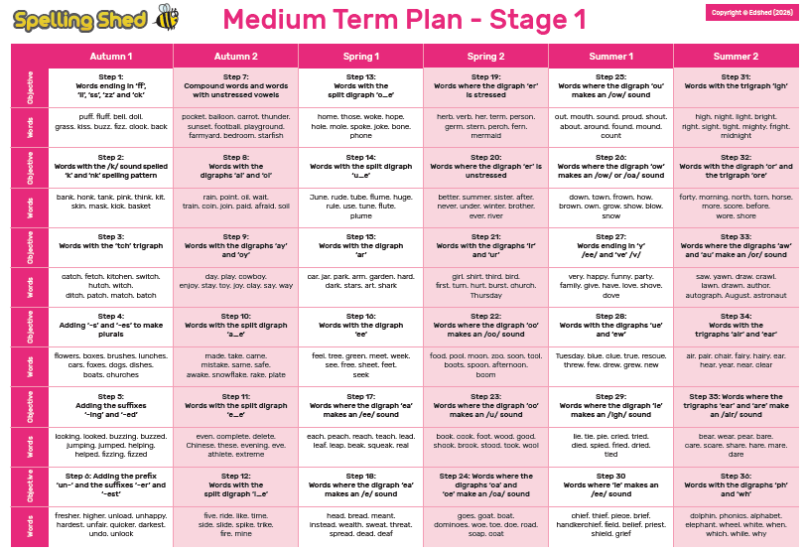
Children will be taught spelling rules for each spelling pattern that are statutory for Year 1 in a stand alone lesson at school and then they will be able to access online games to practise these spellings at home.
There will be no formal weekly test.
Class teachers will monitor progress electronically and set tasks weekly.

Slide 27
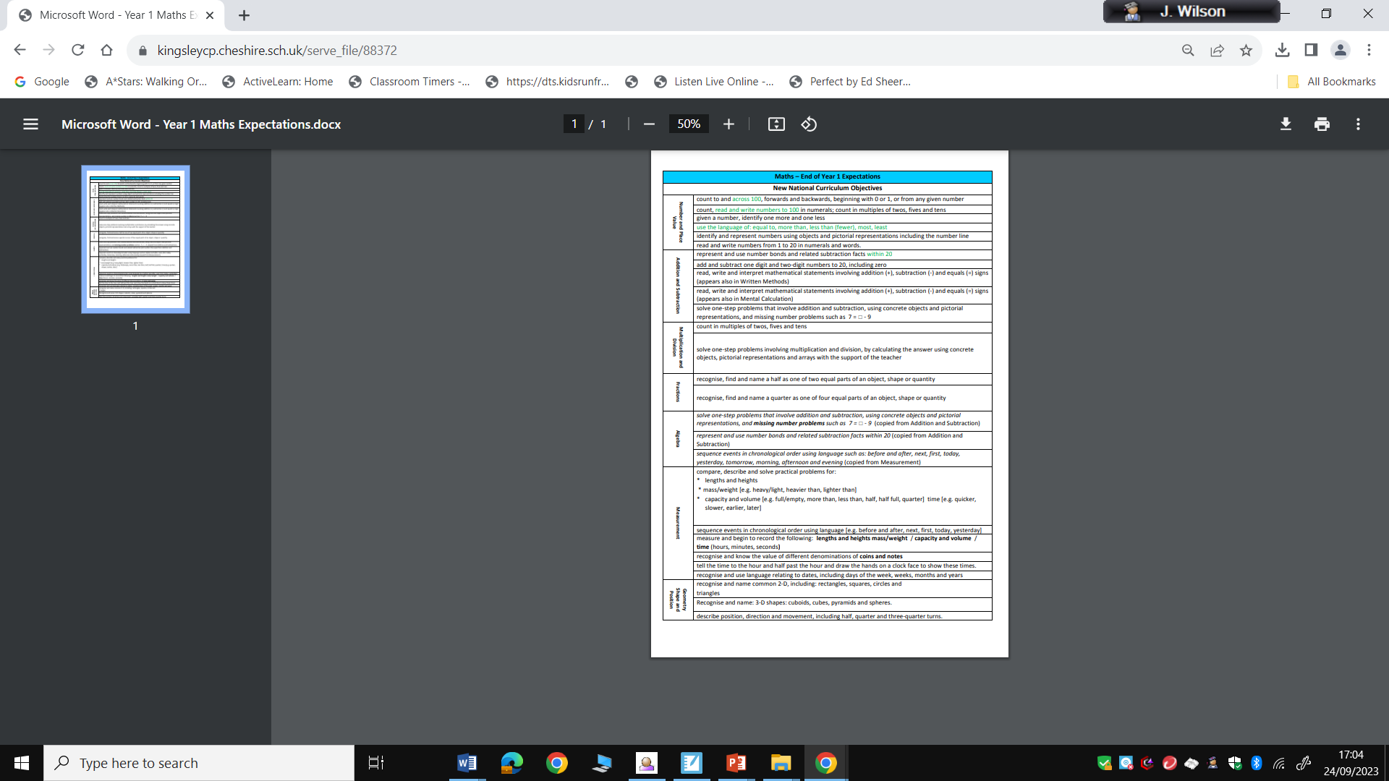
Maths Expectations
Maths can be split into 5 key areas
Number and place value
Calculation
Fractions
Measurement
Geometry
.

Slide 28

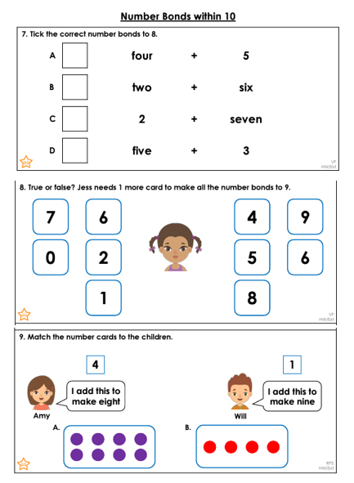
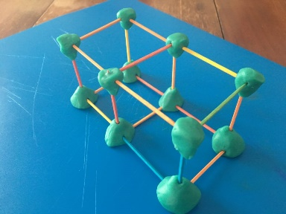
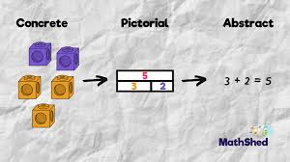
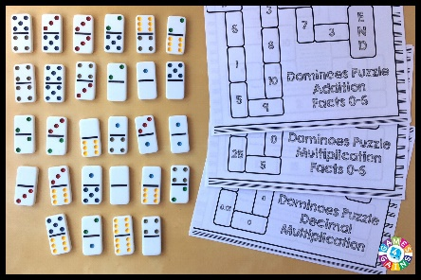
Maths Curriculum
We use Abacus as a base scheme to teach maths to all pupils at the Infant and Junior school.
This ensures continuity and progression between classes and year groups.
.
Concrete – Pictorial – Abstract
Challenge – apply their skills using
reasoning & problem solving

Slide 29
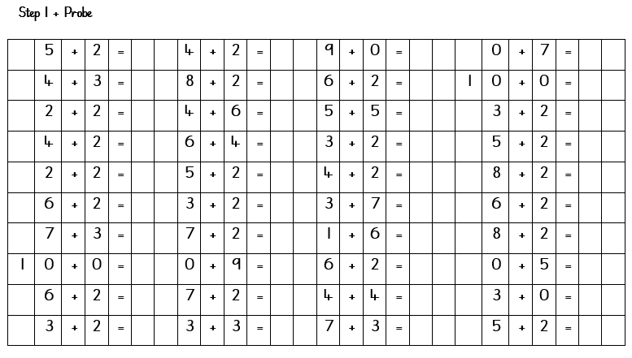

Maths Fluency
Maths fluency for Key Stage 1 involves the rapid, accurate, and flexible recall of basic number facts and concepts, allowing children to select and apply efficient strategies for solving problems.
Key components include number sense, the ability to use different methods for the same problem, recalling core facts with ease, and applying these skills across various mathematical contexts and representations.
.
Flashback 4

Slide 30
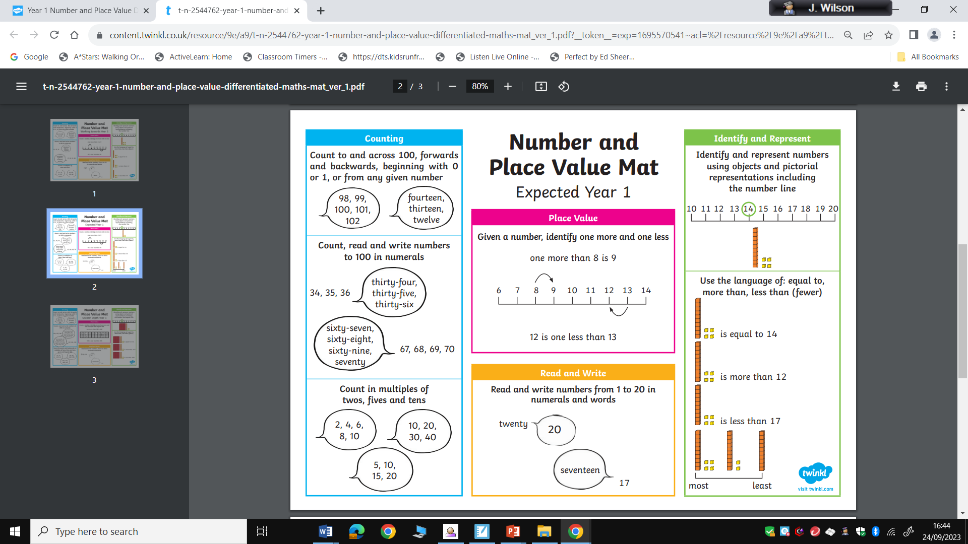

Slide 31
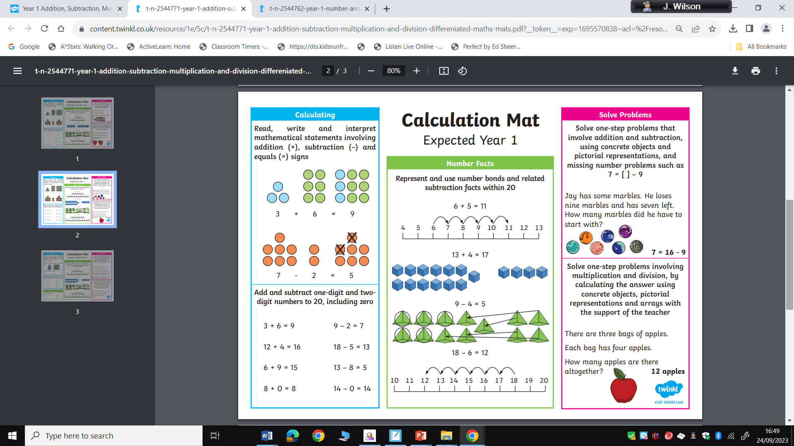

Slide 32
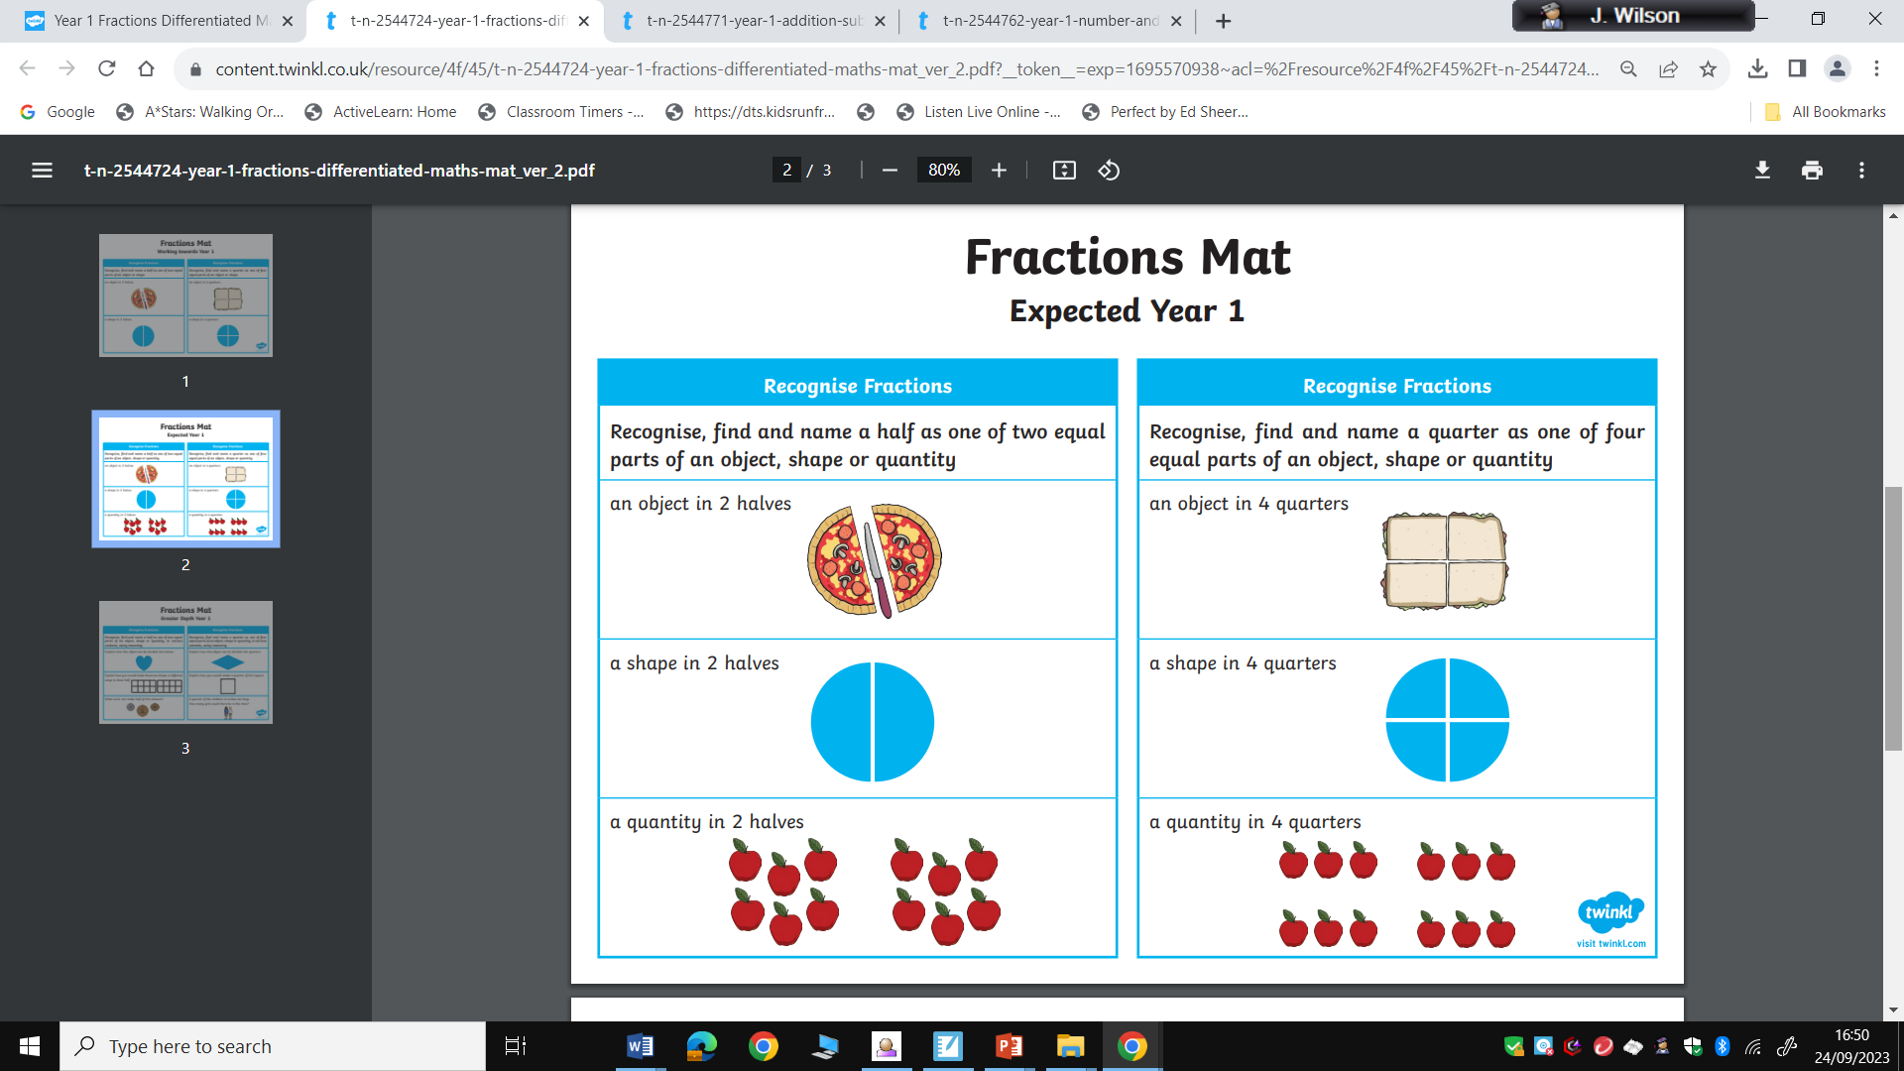

Slide 33
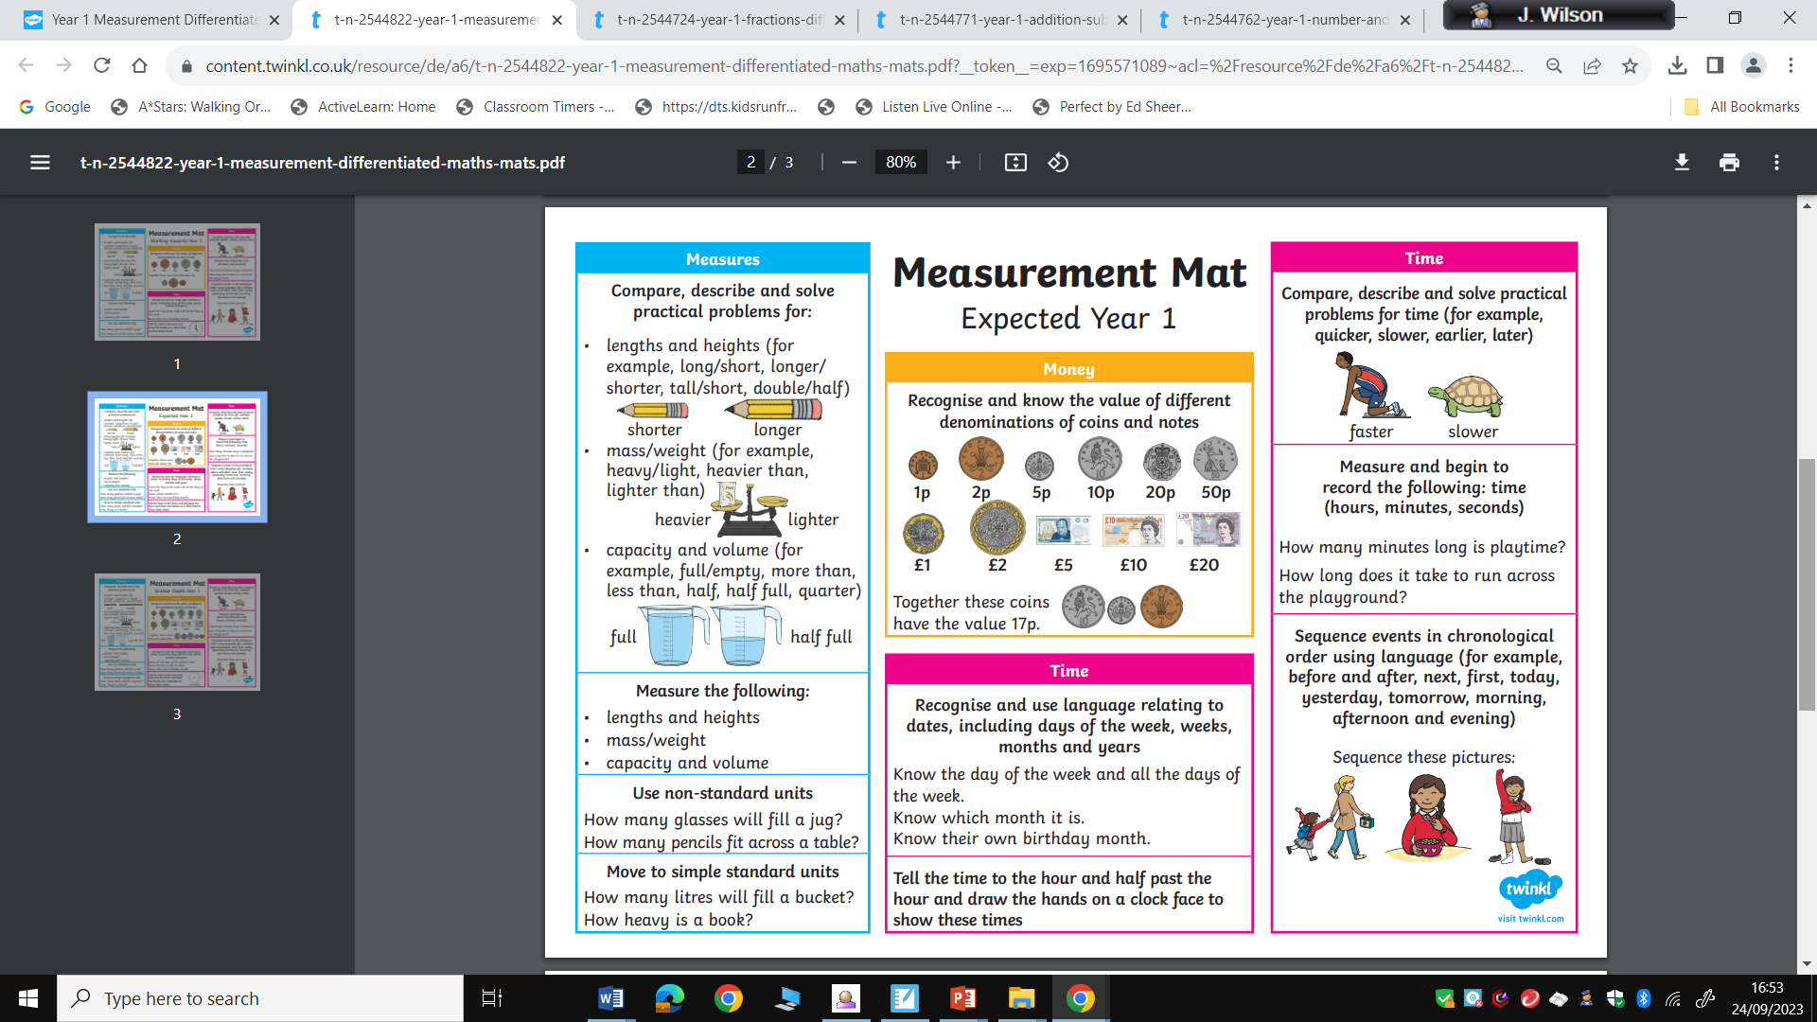

Slide 34
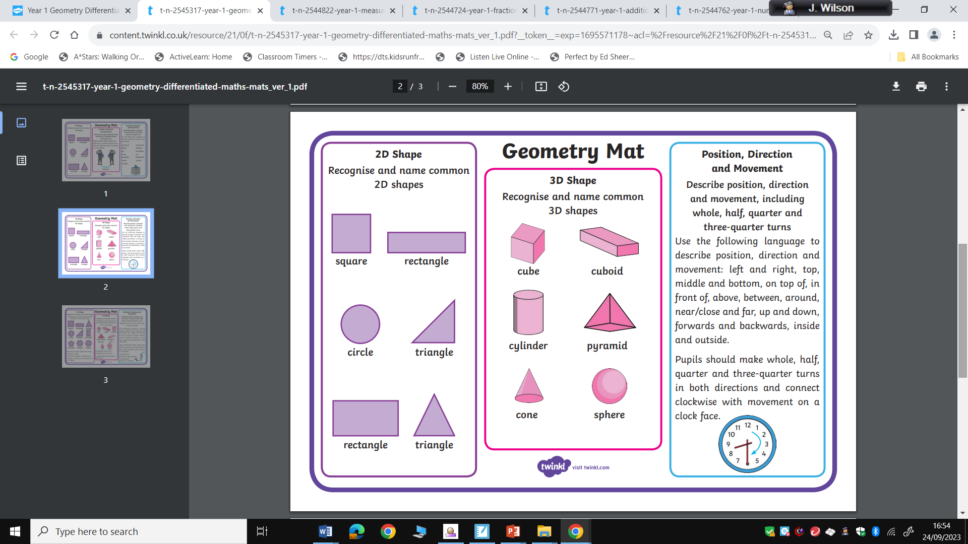

Slide 35
Maths at home
Counting games (snakes and ladders, any dice games)
Recognising numbers when out and about (house numbers, car number plates)
Using money (buying things from the shops, finding out the change)
Counting when out and about (counting cars, steps, items at the supermarket)
Recognising shapes (buildings, windows, nature)
Helping in the kitchen (weighing out ingredients, time, counting out amounts of food)
Be positive!

Slide 36
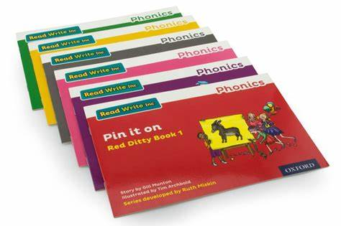





Homework
Phonic Book (RWI) – Please encourage your children to share these and showcase their learning from the week. Speedy red and green words should be revisited and comprehension questions are also in the back.
Guided reading book (Book Bag Book)– please share these with your child. They will have shared this book within their reading group. There are questions at the back of the book to support comprehension. Please do no tell them their book is too easy! They are matched to their phonic ability and should not be too tricky. Praise their achievements. Children are assessed weekly during group sessions and every six weeks through RWI. PLEASE KEEP BOOKS IN BAGS
Spelling Shed –Children will be taught spelling rules for each spelling pattern that are statutory for Year 1 in a stand alone lesson at school and then they will be able to access online games to practise these spellings at home.
Numbots– Children will have access to a this highly engaging platform for learning to add and subtract. This will support your child’s understanding, recall and fluency in mental addition and subtraction.
Purple Mash – Children will be able to access all of the cross curricular activities available at home.
CGP – Children are provided with a CGP book to practise grammar and maths skills (Alternate half termly)

Slide 37
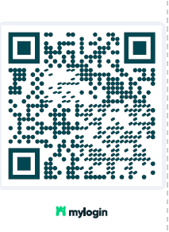
Computing Workshop
In order to access all of these platforms the children will need to login.
We will now be using a log in system called ‘Wonde MyLogin SSO’. This allows pupils to sign in to their apps at school and at home quicker and easier.
They will be given a ‘Magic Badge’ which has a QR code. They scan the QR code to sign them in to all of the learning platforms via the following web address: http://app.login.com/login
Tuesday 14th October 9:30
We will be holding a computing workshop for all parents and guardians in Year 1.
The aim of the workshop will be an introduction to Chromebooks, your child’s Google account and the apps/programs that your child will use in school and at home. It will also show you how your child can access this at home.

Slide 38
Behaviour
P – Persevere – don’t give up.
A – Ambition – reach for the stars
R – Respect – look after our school property and each other
K – Kindness – kind words and actions
H – Honesty – always tell the truth
A – Attitude – always try your best
L – Listening – listen carefully and follow instructions
L – Learning – everyone has a right to learn

Slide 39


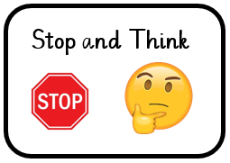
Sanctions
Our aim is to stay green on our good to be green display wallet.
If children are not ‘getting it right’ and are not making good choices, their behaviour has consequences…
The first sanction is a verbal warning where children are asked to stop their behaviour.
If children choose to continue with the same behaviour, teachers will give a stop and think card.

Slide 40

Sanctions
If children continue with the same behaviour, they are then given a yellow card and will miss 5 minutes of playtime.
Children may be given a straight yellow card for:
Defacing / damaging school property
Bad language
Injury due to rough play
Leaving the classroom without permission / being inside at playtimes unless for a reason
Lying / not taking ownership

Slide 41
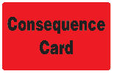
Sanctions
If children continue with the same behaviour, they are then given a red card and will miss playtime to speak to Year Group Leader or Head of School.
Children may be given a straight red card for:
Deliberate injury to another child
Stealing
Lying / not taking ownership (in addition to other yellow card behaviours)

Slide 42
Rewards
Children are allocated a house (red, blue, green, yellow) to earn house points through following the PARK HALL rules.
Each house point is worth 1 point.
A special golden house point from Mrs Hand is worth 5 points.
They receive a bronze, silver or gold award if they have earned 20 HP or more each term.
Children can also earn:
Certificates
Stickers
Gold cup

Slide 43
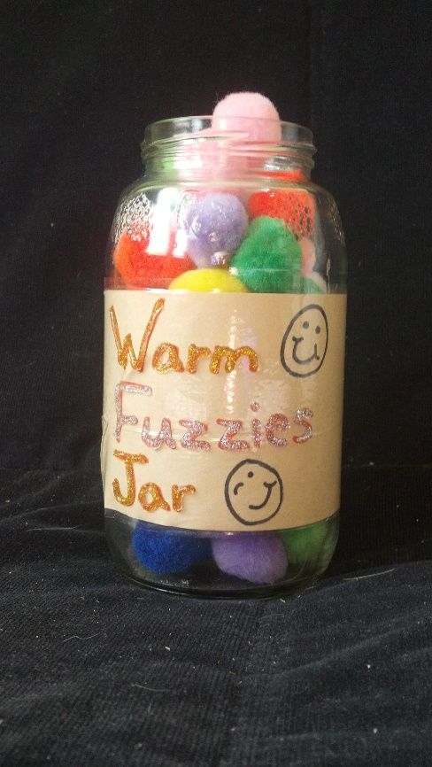

Rewards
Within class, children can also earn ‘warm fuzzies’ for their table pots.
The table with the most ‘warm fuzzies’ each week gets a sticker.
At the end of each half term, the table with the most ‘warm fuzzies’ will get first choice of activity for ‘Golden Time’ such as Lego, iPads, crafts etc.

Slide 44

Thank you
We operate an open door policy at Park Hall. Please don’t hesitate to come and speak to the class teacher or teaching assistant.
Parents evening will be on Tuesday 11th November and Thursday 13th November
Feedback form – via Google Forms

