Slide 1
Computing Workshop
Park Hall Infant Academy 2025

Slide 2
House Keeping
No planned fire alarm.
Should the alarm sound, please exit via the doors at the back of the hall.
Please leave your child in the safe hands of our staff who are well trained in fire exit procedures in order to ensure the safety of all.
Assemble at the bottom of the playground

Slide 3
Agenda
We will cover:
Devices
Wonde Mylogin
Commonly used apps/programs
Online Safety – Project Evolve
Nicola Rudge – Online Safety Advisor Walsall Council

Slide 4
Devices
Technology is an integral part of the children's learning
We predominately use Chromebooks at the Infants in our new computing suite
Children also have access to iPads and tablets
Children are encouraged to get a balance between touch screen and keyboards (typing and mouse skills)

Slide 5
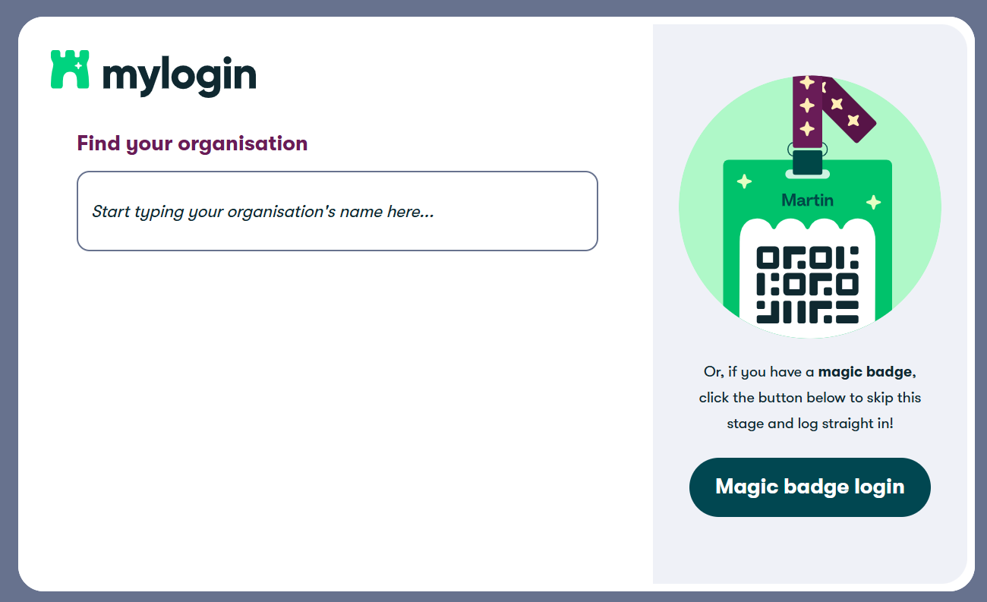
Wonde Mylogin
Platform that allows children to access all apps/programs in one place
Single sign on – no need for lots of usernames and passwords
Magic Badge (QR code) and/or Emoji Password
https://app.mylogin.com/login
Google search bar – mylogin - login

Slide 6
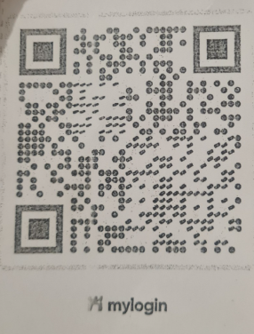
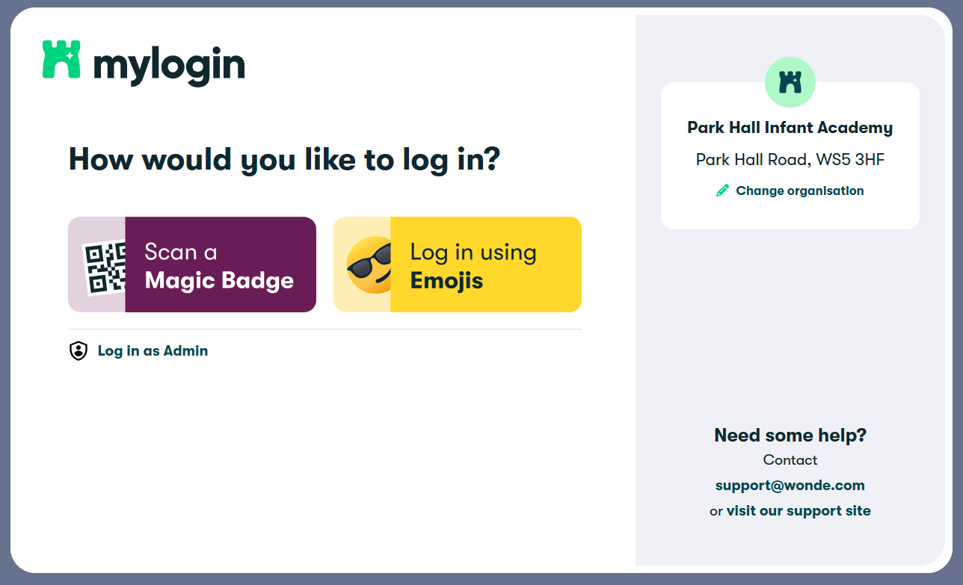
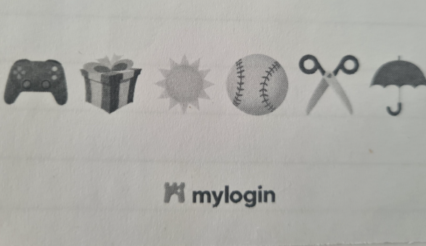
Wonde Mylogin

Slide 7
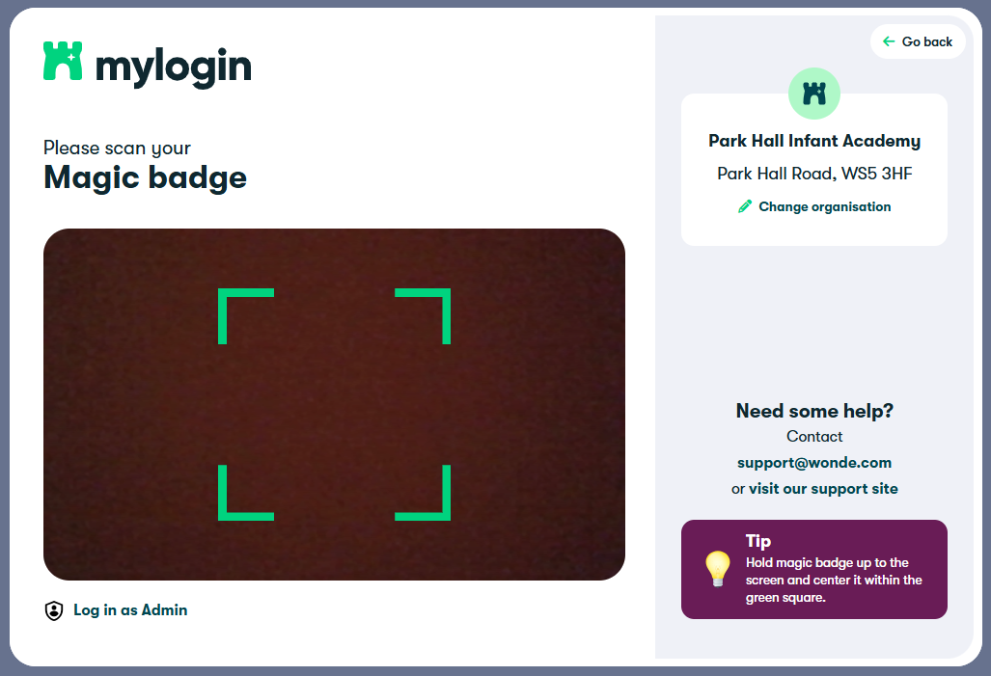
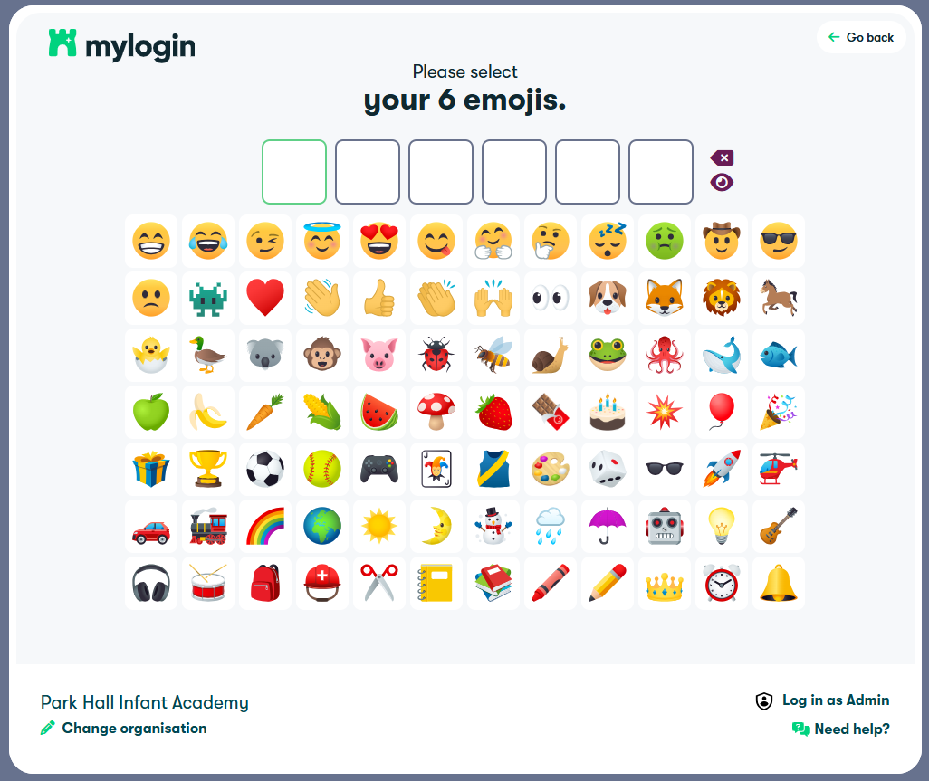
Wonde Mylogin

Slide 8
Commonly used apps/programs
Purple Mash – educational resource, 2Dos, saving, avatar and more
Spelling Shed – assignments, other games, mastery level
Numbots – (To be launched soon for Year 1)
TT Rockstars – (To be launched soon for Year 2)
Teachers will use these apps/programs to set weekly homework however, children can access these apps/programs at any point at home

Slide 9
Online Safety
Scheme - Project Evolve
8 strands:
  Self-Image and Identity
  Online Relationships
  Online Reputation
  Online Bullying
  Health, Wellbeing and Lifestyle
  Privacy and Security
  Managing Online Information
  Copyright and Ownership

Slide 10
Resources and Support
School website
Online Safety newsletter
Walsall Council
CEOP
Internet Matters – https://www.internetmatters.org/
  You can download a family toolkit

Slide 11
Parent Feedback
You will receive a parent feedback form via Google Classroom.
We welcome your feedback on how we have done today in supporting your child’s learning and how we may be able to help further.
Thank you for attending

