Slide 1
Mini Mash Computing Workshop
Park Hall Infant Academy 2026

Slide 2
House Keeping
No planned fire alarm.
Should the alarm sound, please exit via the doors at the back of the hall.
Please leave your child in the safe hands of our staff who are well trained in fire exit procedures in order to ensure the safety of all.
Assemble at the bottom of the playground

Slide 3
Agenda
We will cover:
Online Safety
Wonde Mylogin
Mini Mash - Lucy Jayes

Slide 4
Online Safety
Scheme - Project Evolve
8 strands:
  Self-Image and Identity
  Online Relationships
  Online Reputation
  Online Bullying
  Health, Wellbeing and Lifestyle
  Privacy and Security
  Managing Online Information
  Copyright and Ownership

Slide 5
Online Safety
Five trusted adults – school and home
Ensure your children know they can come to you
Let them know you won’t blame them

Slide 6
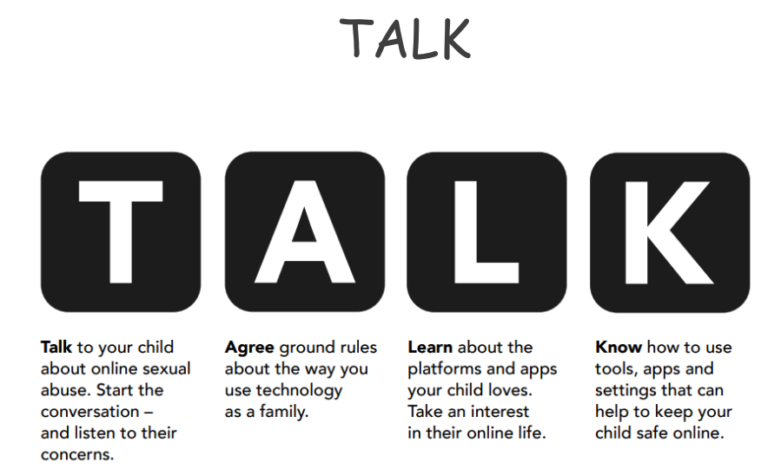
What can you do?
Minimum age requirement

Slide 7
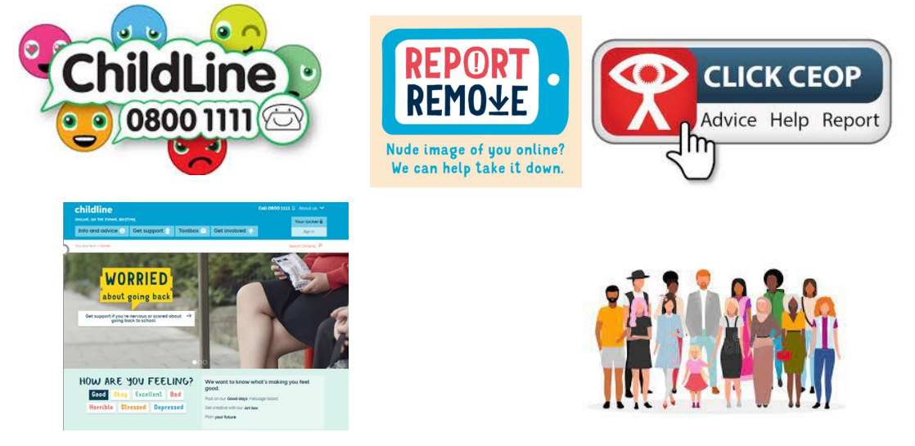
Where can you get advice and support?

Slide 8
Resources and Support
School website
Online Safety newsletter
Walsall Council
Nicola Rudge – Walsall Online Safety Advisor
CEOP
Internet Matters – https://www.internetmatters.org/
  You can download a family toolkit

Slide 9
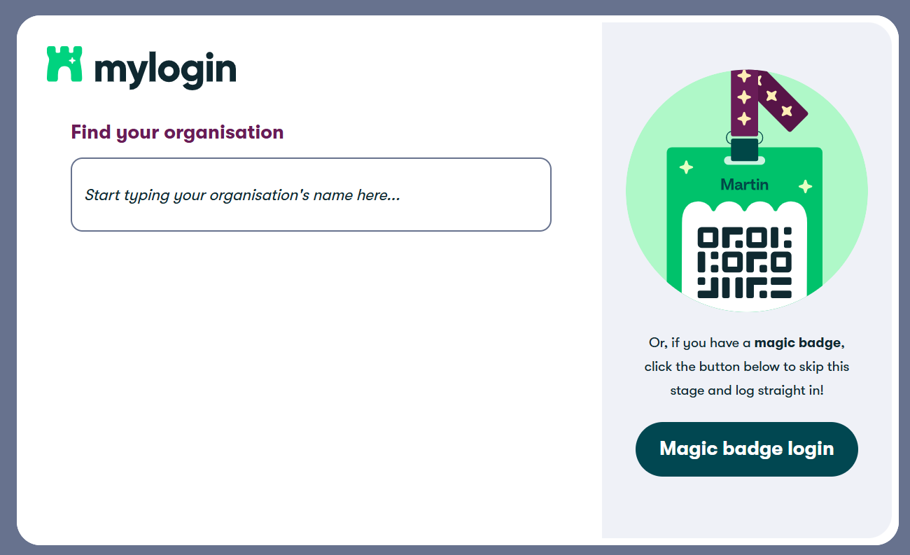
Wonde Mylogin
Platform that allows children to access all apps/programs in one place
Single sign on – no need for lots of usernames and passwords
Magic Badge (QR code) and/or Emoji Password
https://app.mylogin.com/login
Google search bar – mylogin - login

Slide 10
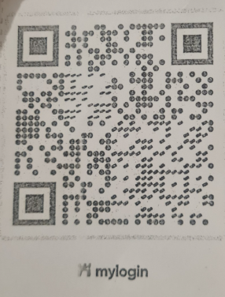
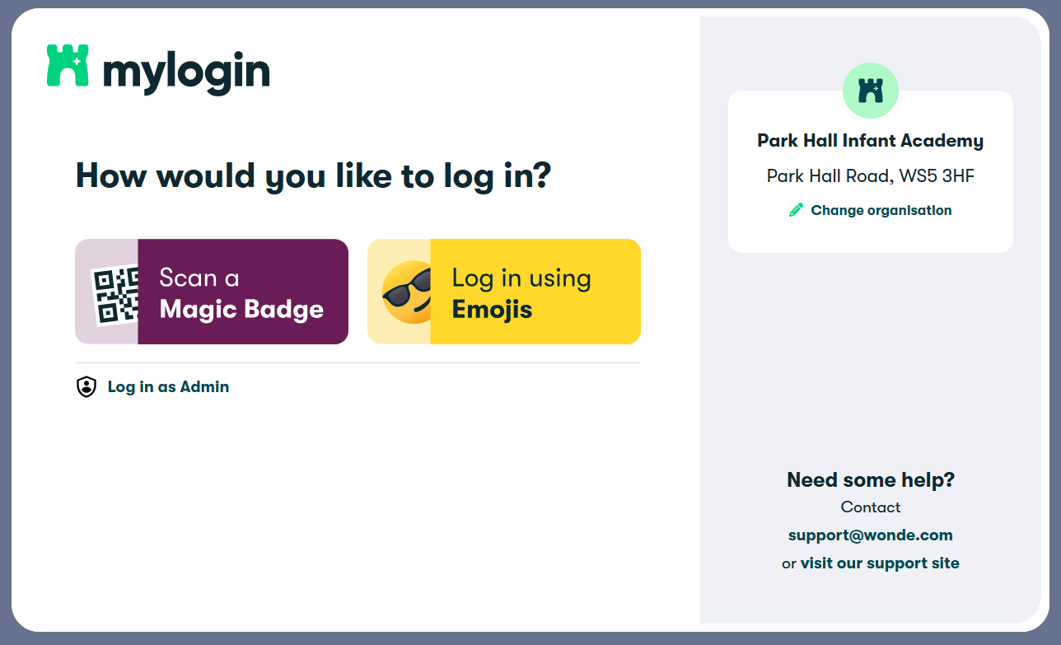
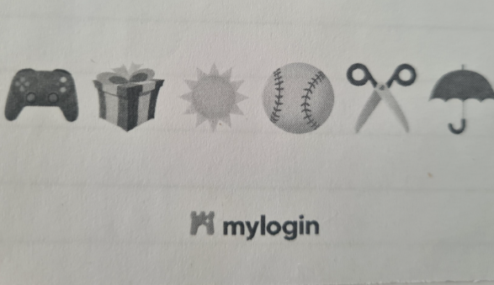
Wonde Mylogin

Slide 11
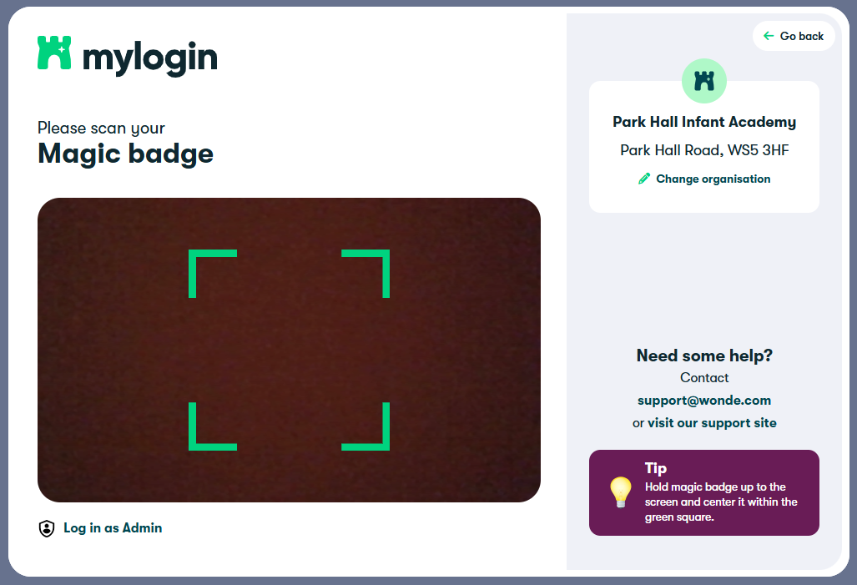
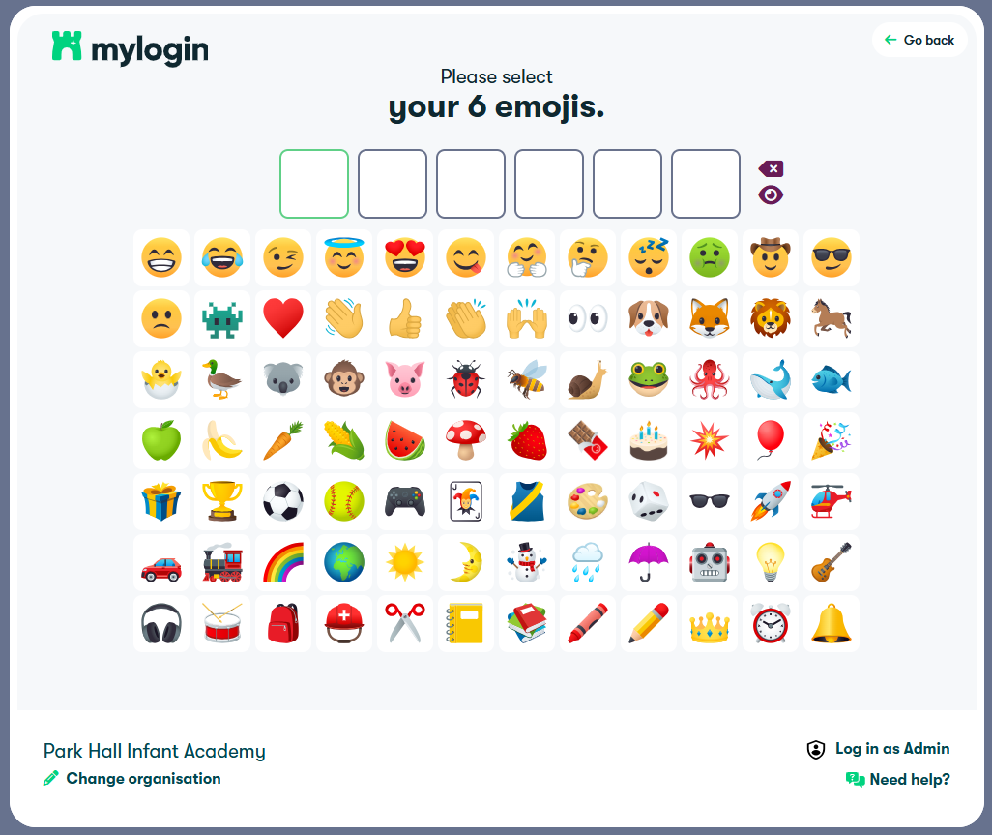
Wonde Mylogin

Slide 12
Parent Feedback
You will receive a parent feedback form via Google Classroom.
We welcome your feedback on how we have done today in supporting your child’s learning and how we may be able to help further.
Thank you for attending

